Slide 1
Digital Patient Registration Transformation
Client: Shree Pathanjali Acupuncture center
Website : https://www.shreepathanjali.in/

Slide 2
Shree Pathanjali Acupuncture center
Prof, Dr.V.Ratna MD(Acu), Ph.D. The President & Founder of Shree Pathanjali Acupuncture center, formerly a degree holder transformed into a Spiritual healer.
At the age of 27 after 3 caesarian with all troubles of bulky Uterus, Liver, GB Stone, Improper functioning of the heart, Started Acupuncture treatment for low back pain,Uterus problem and many others. While treatment, She studied Acupuncture and tried on her own physical body and psychological changes.

Slide 3
Acupuncture
Acupuncture is a natural holistic therapy to cure diseases. It is based on the five elemental theory of nature.
Acupuncture the ancient traditional art of healing involves the use of sharp, thin needles that are inserted in the body at very specific points, has become popular worldwide in the past few decades.
Acupuncture is one of the most ancient and charactistic therapeutic technic of medicine, very broadly speaking a acupuncture technic is from ancient times onwards thought most valuable in both acute and chronic diseases.
Besides being free from side effects commonly encountered in drug therapy, it is a safe, simple & economical form of therapy.

Slide 4
Project Scope
The Digital Patient Registration Transformation project is an innovative initiative aimed at streamlining and modernizing the traditional process of patient medical registration. In this transformative endeavor, handwritten patient registration forms are seamlessly converted into a secure and efficient digital format.

Slide 5
Benefits
Enhanced Accuracy: Minimize errors associated with manual data entry through automated recognition technology.
Improved Accessibility: Access patient records anytime, anywhere, facilitating better collaboration among healthcare professionals.
Cost-Efficiency: Reduce paper usage and associated costs while optimizing administrative workflows.
Patient Empowerment: Enable patients to complete registration processes with ease, fostering a positive and efficient healthcare experience.

Slide 6
Project Requirements
Advanced Handwriting Recognition Technology:
Implement cutting-edge handwriting recognition algorithms or utilize pre-trained machine learning models to accurately transcribe handwritten content.
Regularly update and refine the recognition model based on real-world data to improve accuracy over time.
User-Friendly Interface:
Design an intuitive and user-friendly interface for both healthcare professionals and patients, ensuring a seamless transition from traditional to digital registration.
Incorporate features such as form validation, real-time feedback, and easy navigation to enhance user experience.

Slide 7
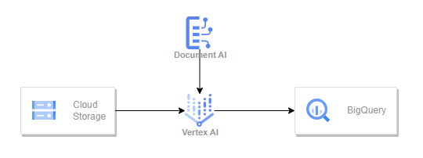
Project Architecture

